Slide 1
Using EarthExplorer to Generate Scene Stacks

Slide 2
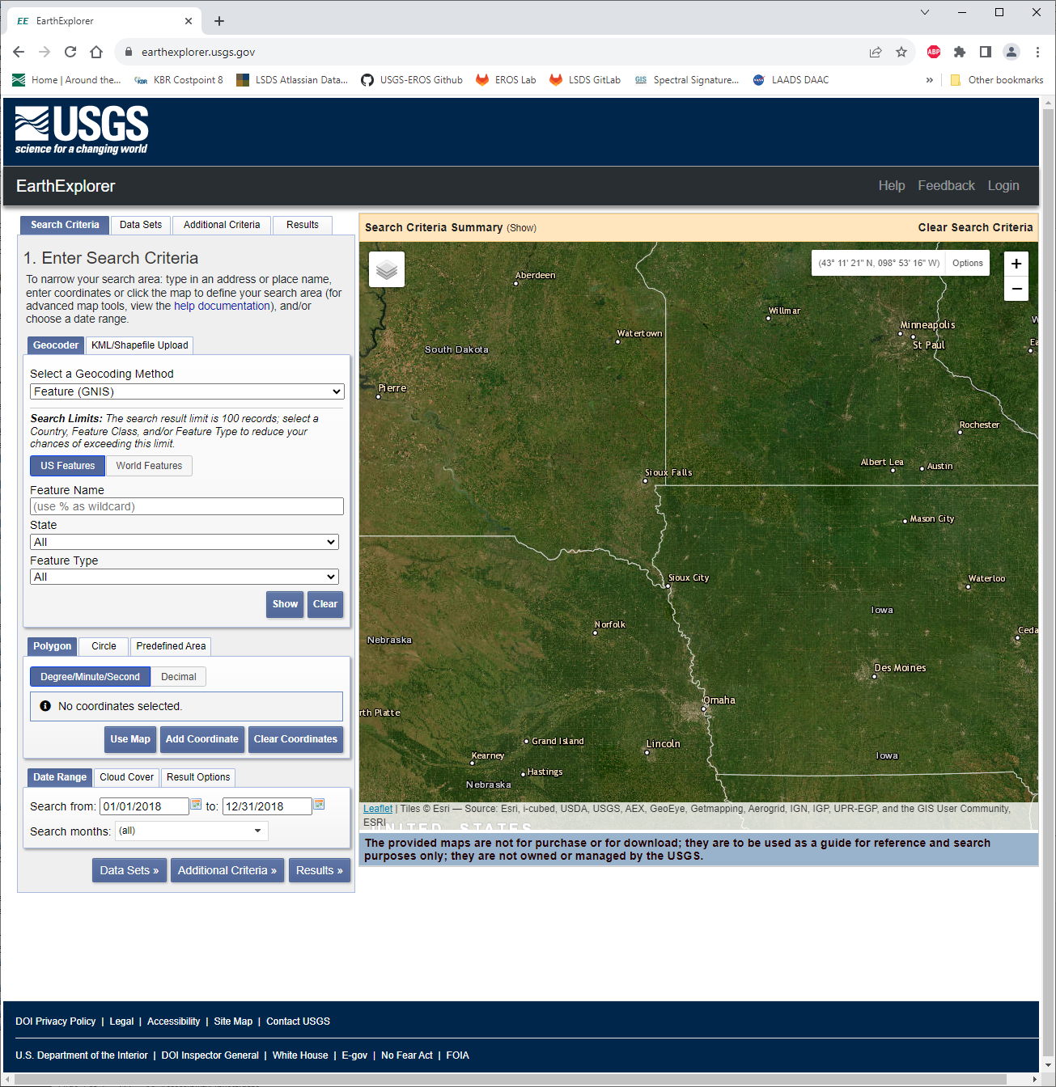


Notes:
Open EarthExplorer: https://earthexplorer.usgs.gov/
Login using your credentials
Specify your desired date range

Slide 3
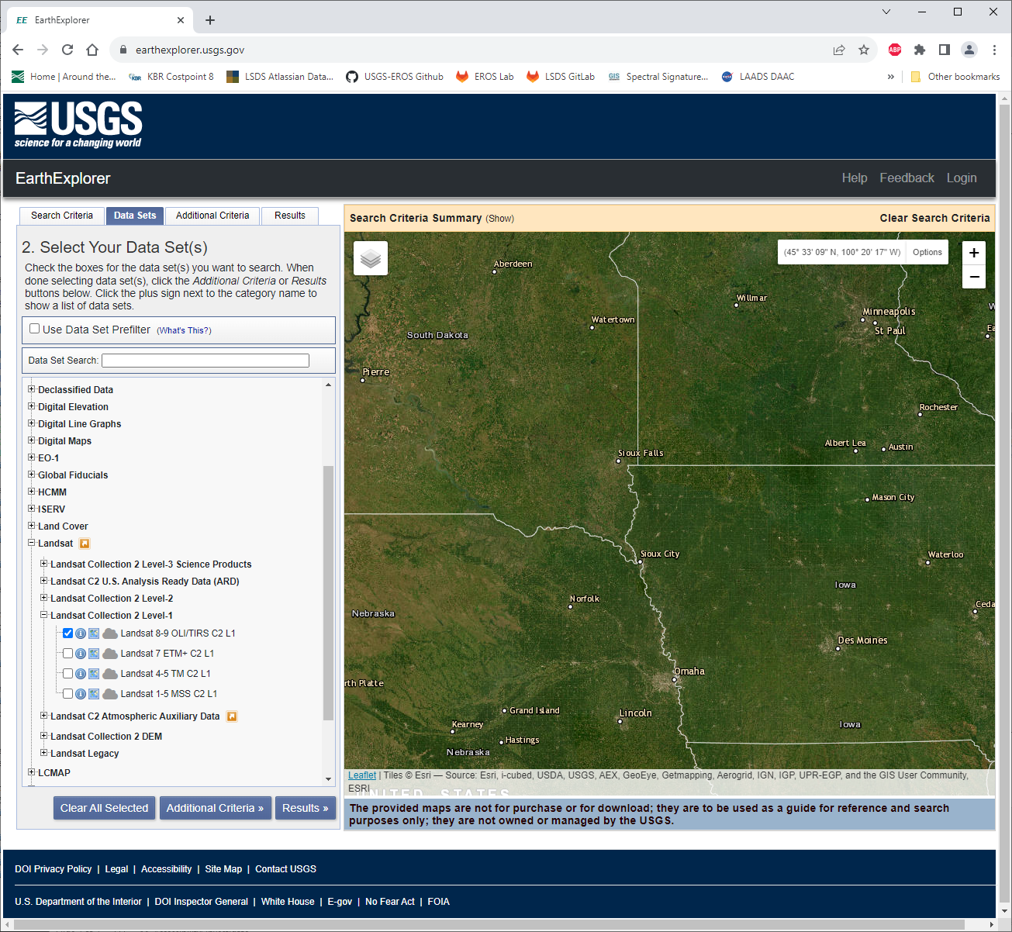


Notes:
Click on the Data Sets tab
Select Landsat Collection 2 Level-1
Select Landsat 8-9 OLI/TIRS C2 L1

Slide 4
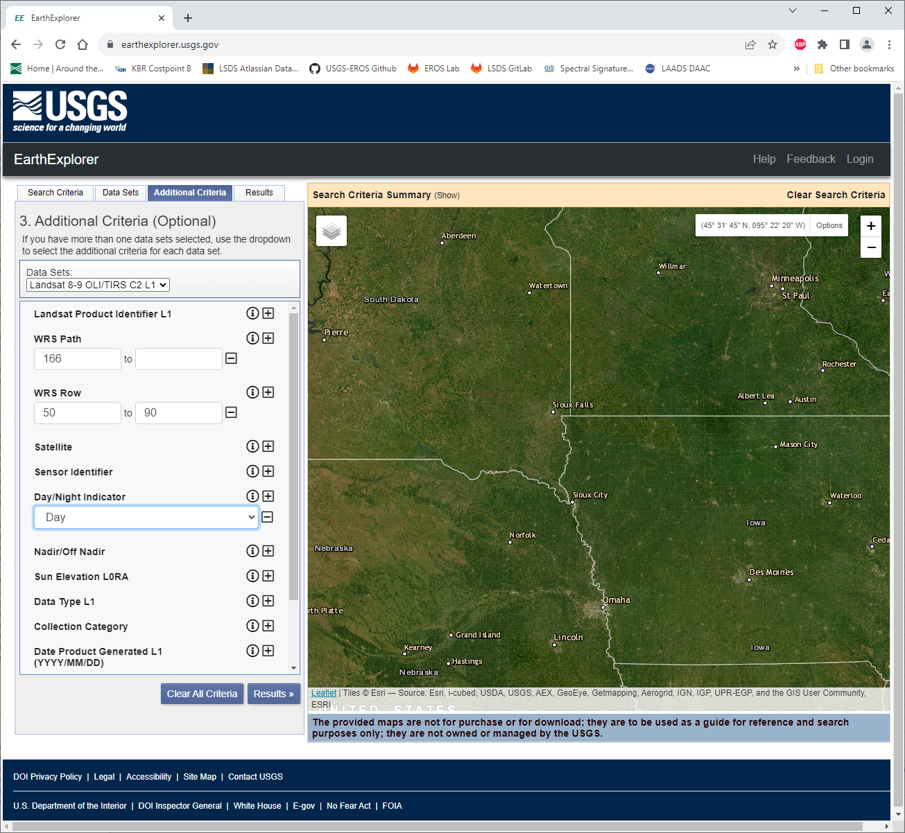


Notes:
Select Additional Criteria tab
Specify your WRS path/row criteria (multiple path/rows can be specified at one time)
Specify Day for the Day/Night Indicator so no nighttime scenes are generated

Slide 5
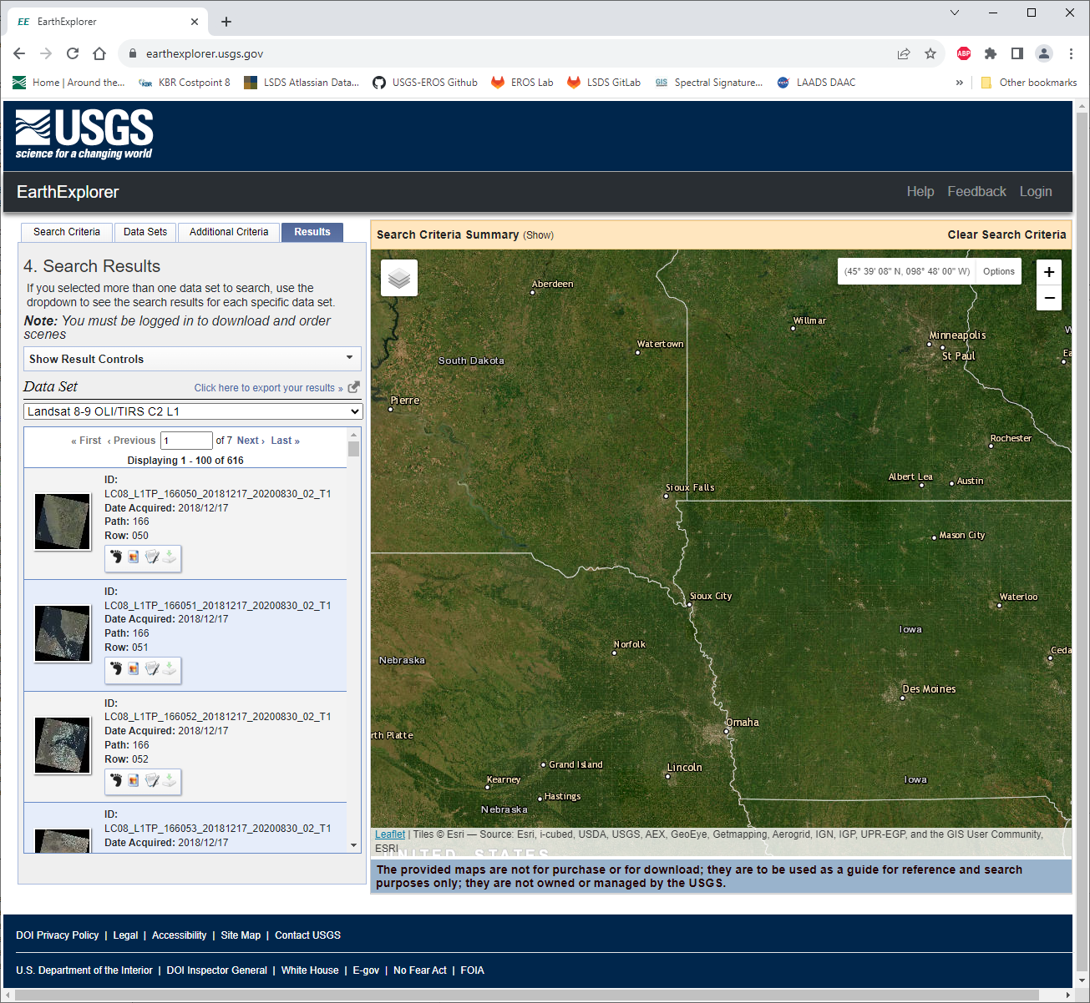
Notes:
On the Results tab you will see your list of scenes, based on your specified criteria from the previous 3 tabs.
Select Click here to export your results

Slide 6
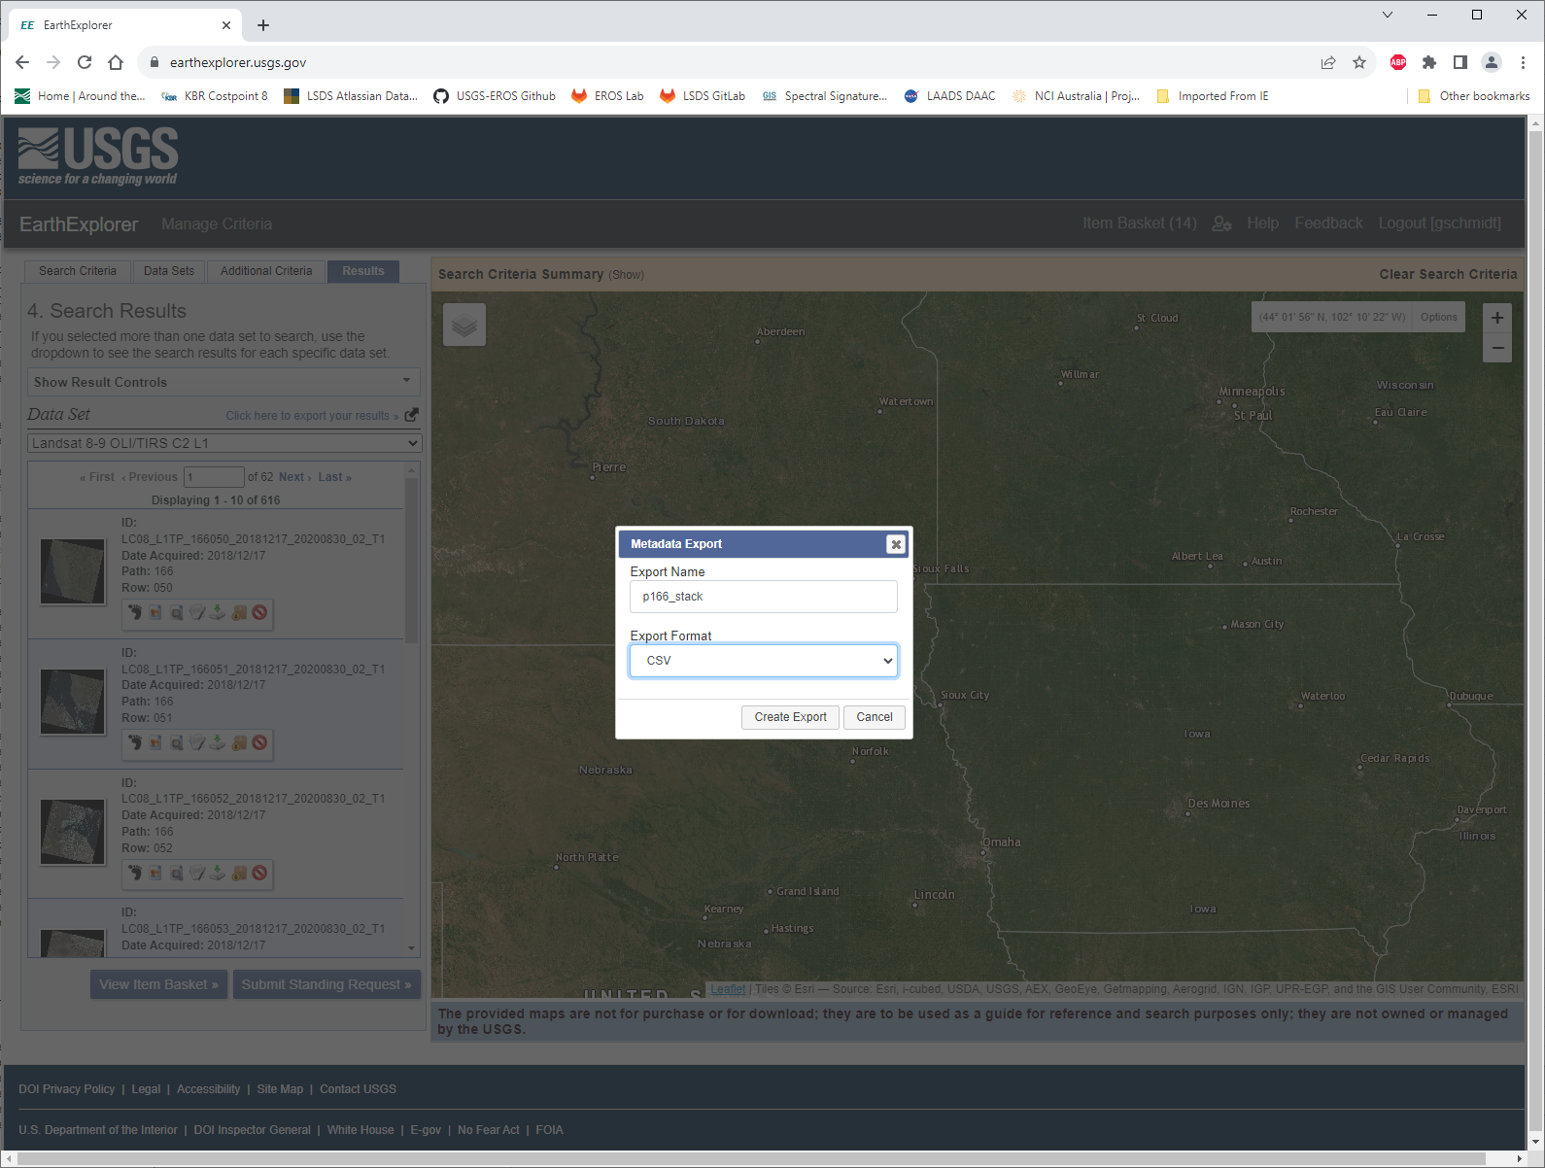

Notes:
Choose a filename to save your metadata
Choose CSV as your file format
Create your export

Slide 7
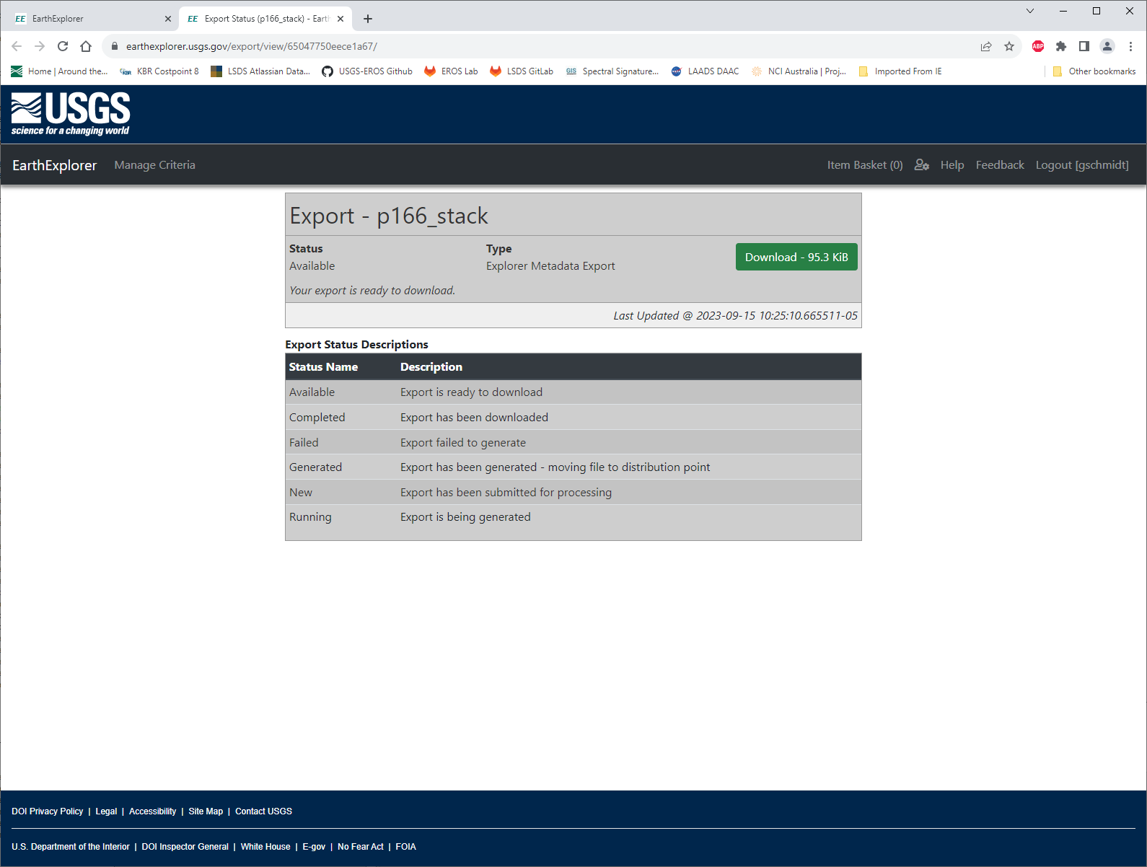

Notes:
Once your export is ready, a popup will be available. Select Open Export Status page, then download the .zip file.
Save the .zip file
Unzip the file

Slide 8
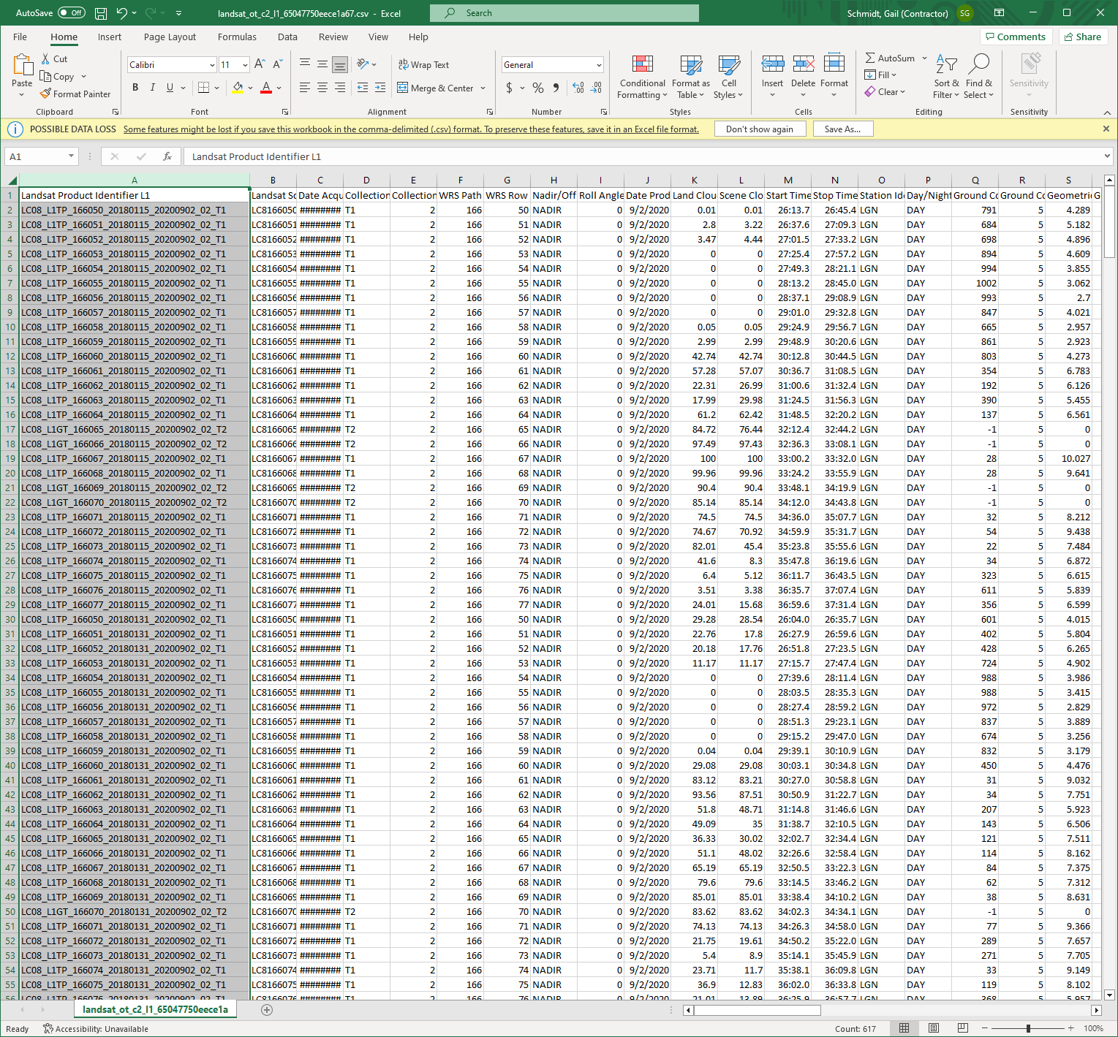
Notes:
Open the CSV file in Excel.
We need to keep the scenes in the first column (Landsat Product Identifier L1)
Select Columns B through DF (even though some of them are empty)
Delete the columns
Delete the first row which contains the column titles (i.e. Landsat Product Identifier L1)

Slide 9
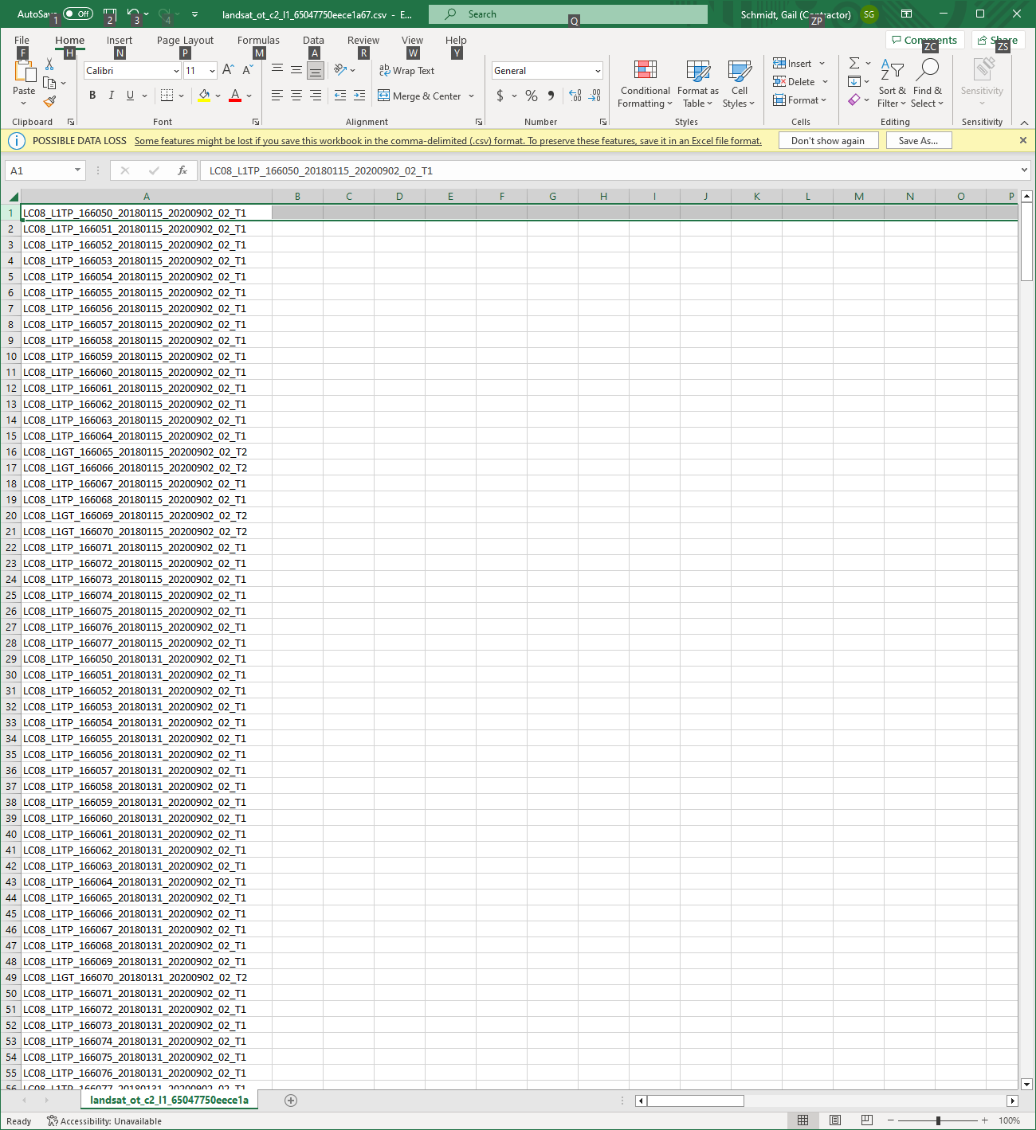
Notes:
Your cleaned up CSV file will look like the following

Slide 10
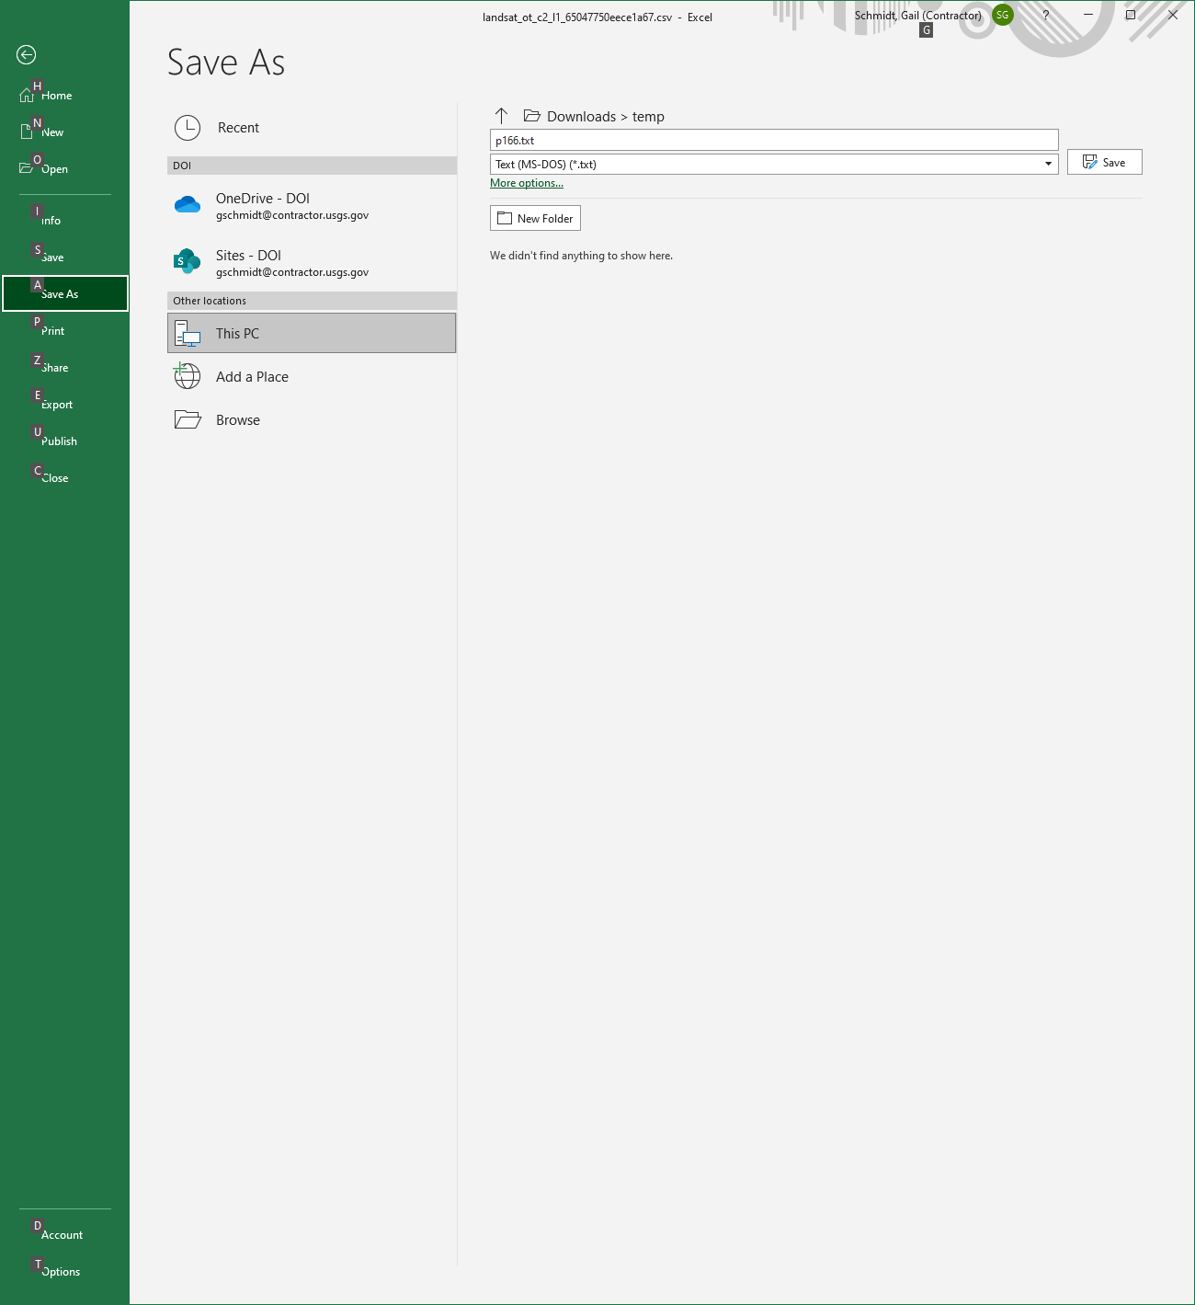

Notes:
Save the CSV file as an MS-DOS txt file. This will generate a .txt file with each scene on a single line.

Slide 11
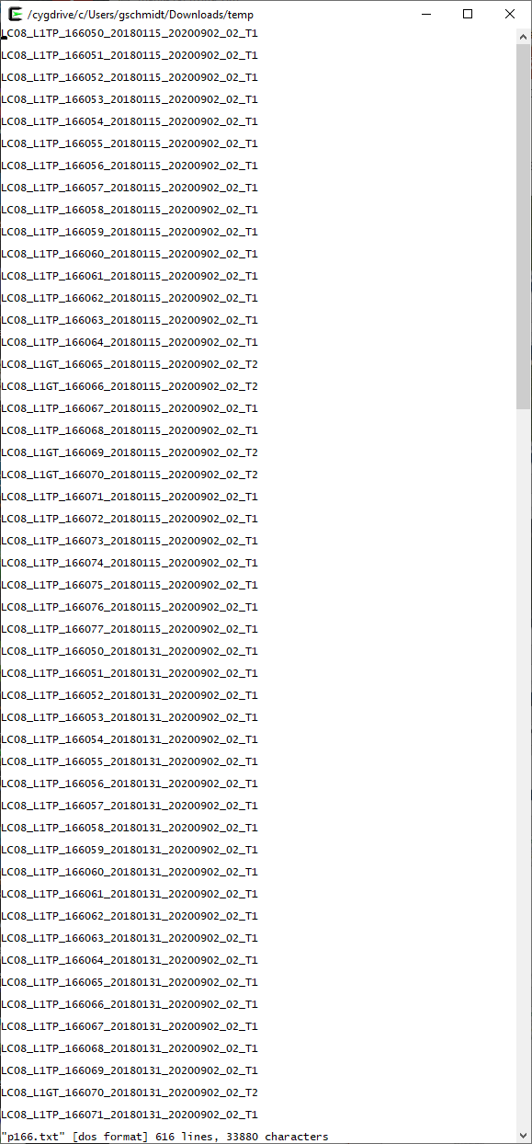
Notes:
If you look at your .txt file and it has extra characters after the scene name, then you likely didn’t delete enough columns in the original CSV file. There should not be any characters after the scene name.

Slide 12
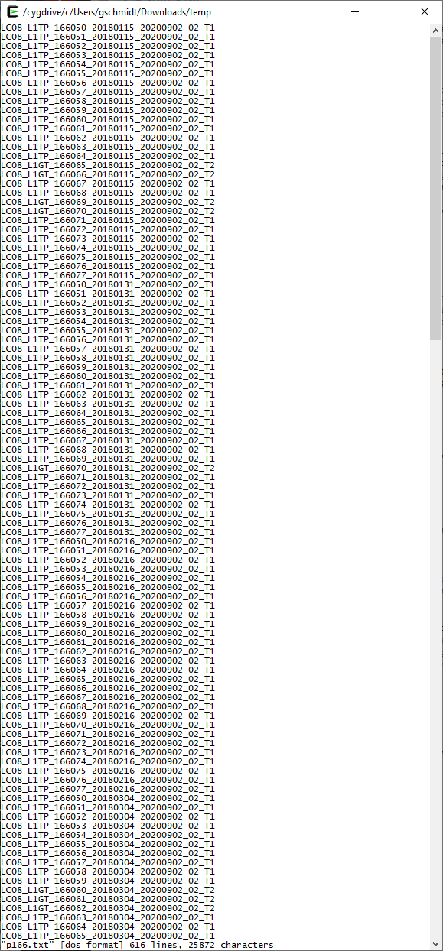
Notes:
This is how the .txt file should look. Scene name only. One per line.
This is the .txt file that you will feed to ESPA for placing your order.

Slide 13
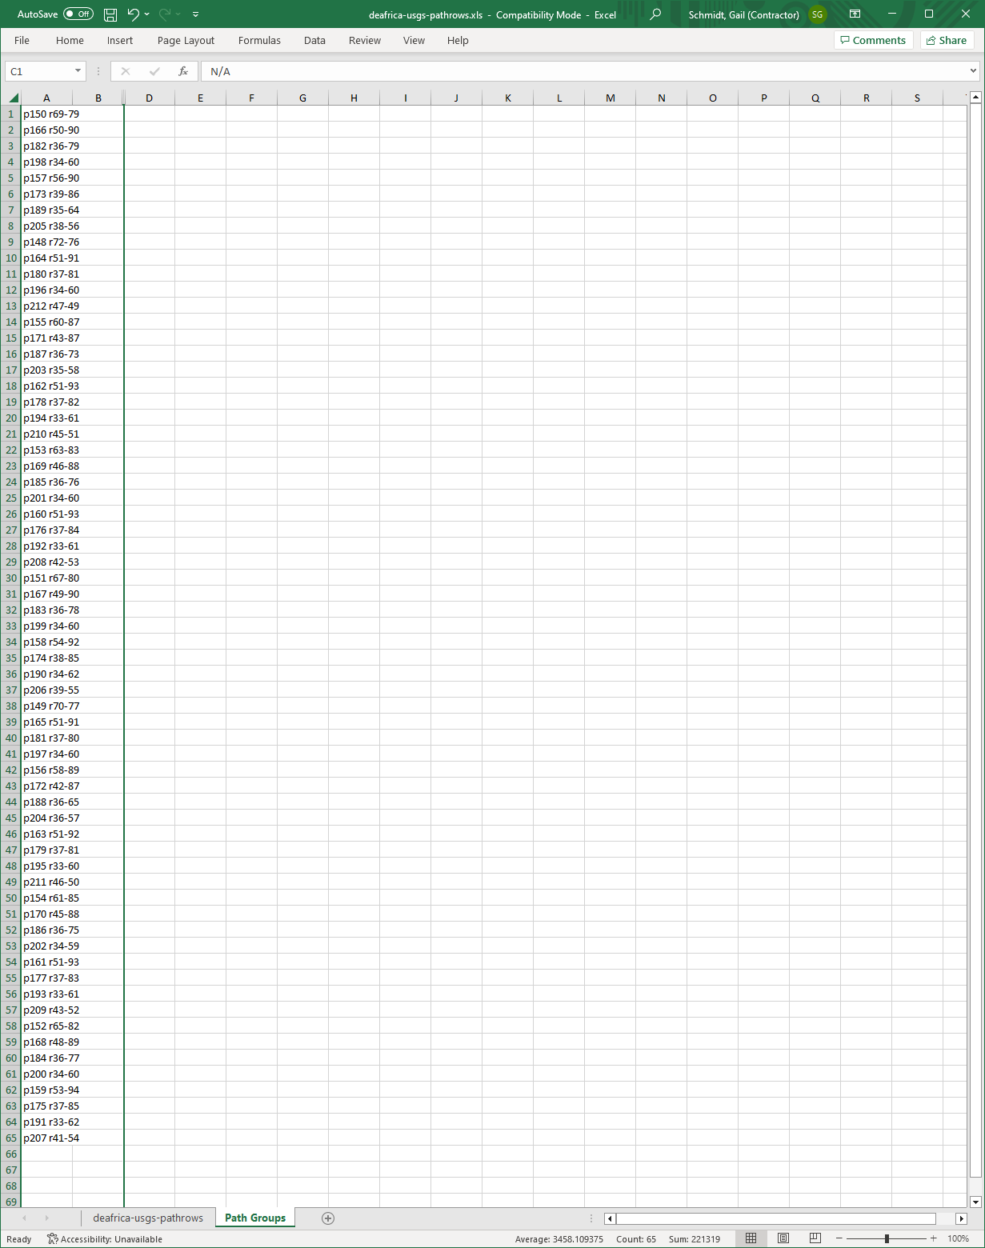
Notes:
These are the path/row groups that I used previously to generate the stack of .txt files for 2020-2023. If you follow these steps for each of the path/row groups, that should generate 65 stack files (.txt) for you to place your orders in ESPA.

